Slide 1
Real-Time Global Illumination Techniques
Julius Narvilas

Slide 2
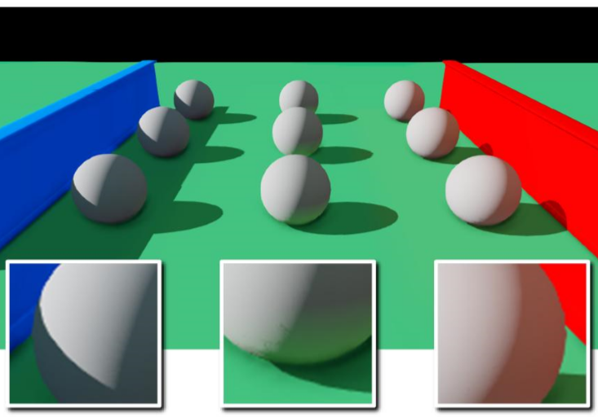
Introduction
As the demand for realistic graphics in video games continues to rise, there is interest in efficiently achieving advanced visual effects like global illumination for real-time applications. Rasterization based graphics processing hardware is considered not well suited to simulate light behaviour but is now powerful enough to approximate lighting in different ways.
Global illumination example [1]

Slide 3
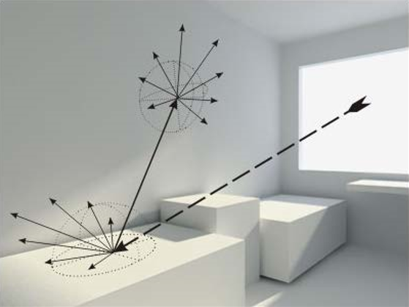
Ray Tracing
Rays are cast from every pixel into the environment, fallowing the viewing direction. This creates paths that most photons would have taken to reach those screen pixels. The intersected surface points indicate the transported colour that contributes to the pixel shading [3].
Example of rays being cast [2]

Slide 4
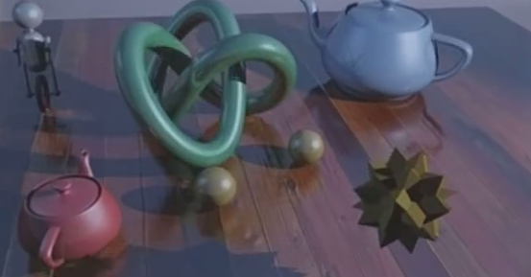
Ray Tracing
Imagination Technologies have been pursuing a fully ray traced rendering solution. In 2014 the company announced PowerVR Wizard GPU family and promised to provide 300 million rays per second [3].
In 2016 at Consumer Electronics Show (CES) PowerVR GR6500 GPU was used to showcase dynamic ray traced scenes in real-time [4].
Real time ray tracing rendering [4]

Slide 5
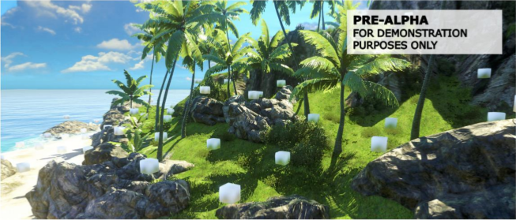
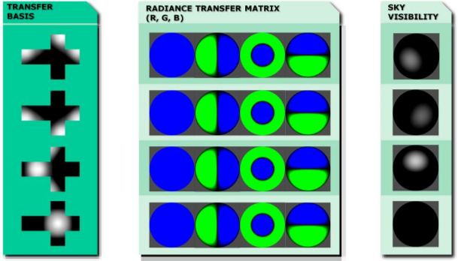
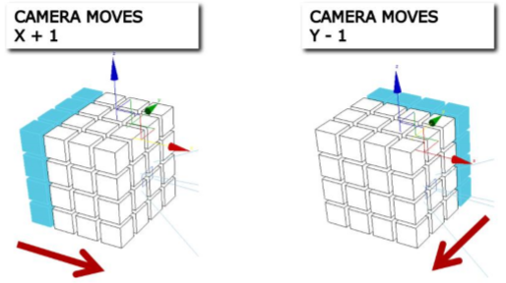
Deferred Radiance Transfer Volumes
A mixture of offline and online techniques used in Far Cry 3. The implementation is focused around precomputed probes that are used while lighting the scene to approximate global illumination in real-time.
Far Cry 3 GI technique steps [5]

Slide 6
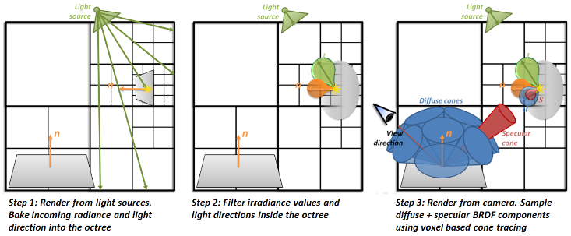
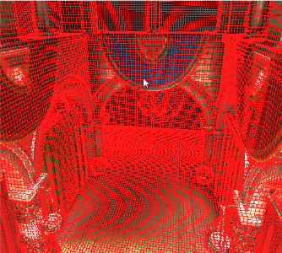
Voxel Cone Tracing
This approach is focused on pre-filtered hierarchical voxel representation of the scene geometry. GPU is extensively used to provide storage and computation.
First the scene is rasterized from the point of view of each light source to injecting radiance. Then it is rendered from the camera’s point of view, using approximate cone tracing to make the final gathering of light information.
VCT octree example [6]

Slide 7
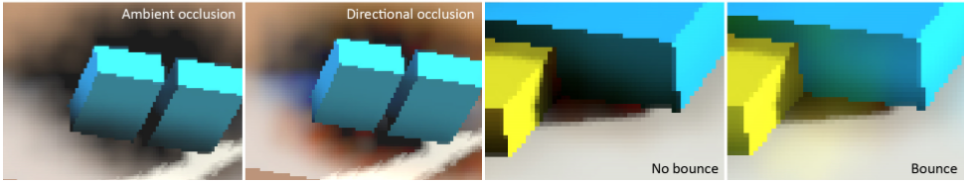
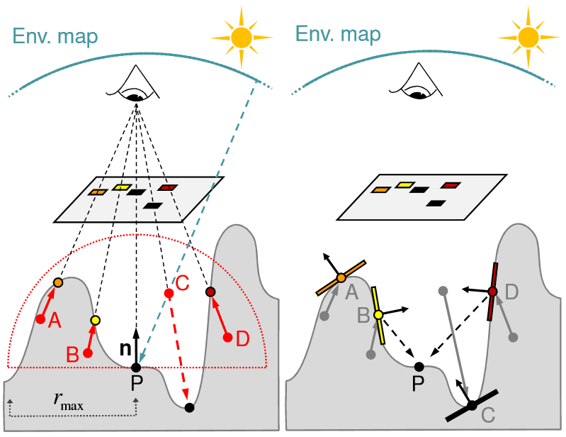
Screen Space Directional Occlusion
Ambient occlusion is a technique to calculate how receptive to ambient light a point in the scene should be. There are several implementation variants of this technique and SSDO is one that introduces one bounce indirect illumination.
The average visibility value is computed from multiple sampling directions, uniformly distributed over the hemisphere. Sample points below the surface are treated as occluders and are considered for influencing the ambient colour
SSDO examples [7]

Slide 8
Summary
Although the way current GPUs address rendering is not well suited for simulating lighting, ray tracing can still become the dominant rendering approach in the future.
Currently the rasterization based lighting approximations are more suitable to achieve interactive frame rates.
VCT and SSDO appear to be the best solutions that can address different market needs.

Slide 9
References:
[1] Gilabert, M., & Stefanov, N. (2012). Deferred Radiance Transfer Volumes. Game Developers Conference
[2] Cyril Crassin, Voxel Cone Tracing and Sparse Voxel Octree for Real-time Global Illumination, presentation slides, NVIDIA Research
[3] Imagination Technologies. (2014, March 18). Imagination Technologies blog. Retrieved from http://blog.imgtec.com/powervr-developers/powervr-gr6500-ray-tracing
[4] Imagination Technologies. (2016, January 7). Imagination Technologies blog. Retrieved from http://blog.imgtec.com/powervr-developers/real-time-ray-tracing-on-powervr-gr6500-ces-2016
[5] Gilabert, M., & Stefanov, N. (2012). Deferred Radiance Transfer Volumes. Game Developers Conference.
[6] Crassin, C., Neyret, F., Sainz, M., Green, S., & Eisemann, E. (2011, September). NVIDIA Research. Retrieved from https://research.nvidia.com/publication/interactive-indirect-illumination-using-voxel-cone-tracing
[7] Ritschel, T., Grosch, T., & Seidel, H.-P. (2009). Approximating Dynamic Global Illumination in Image Space. I3D, (pp. 75-82).

